Slide 1

New Release of
VuFind Summit 2016
Robert Haschart
University of Virginia

Slide 2
Original SolrMarc
Started in 2008 by Wayne Graham, Andrew Nagy, Naomi Dushay, and Robert Haschart
Designed from the beginning to build Solr indexes for both VuFind and Blacklight
Designed with Simple Index Specification, plus translation maps, plus Custom Index Methods
Notes:
Started in 2008 by
Wayne Graham then of College of William and Mary,
Andrew Nagy then from this fine Institution,
Naomi Dushay from Stanford University,
Me from the University of Virginia
It was designed from the beginning to build Solr indexes for both VuFind and Blacklight

Slide 3
Reasons for New Version
Supports simple indexing specifications, but beyond that requires a custom index method.
Source file of custom index methods grows large and unwieldy.
Incremental improvements added beanshell scripts, and compiled mixins – not enough
Hard to upgrade since it tried to work with multiple different versions of Solr.
Notes:
Although it does support “simple” index specification, I have found in practice that nearly everything ends up needing a custom method.
Consequently the source file containing these custom methods grows large and unwieldy.
And while incremental improvements have been made over the past several years, like adding support for beanshell scripts, or compiled indexing Mixins it really hasn’t made SolrMarc that much easier to configure and use and extend.
Furthermore, since SolrMarc has always tried to work with multiple different versions of Solr, it has been hard to upgrade and therefore often slow to upgrade, which has made it a roadblock for projects relying on it.

Slide 4
The Start of a New Version
Thanks to Oliver Obenland of The University of Tübingen
“Precompile” index specifications once
Represent Index specification as an Extractor, zero or more Maps, plus a Collector.
Plus an “alternative” way of adding custom methods.
Notes:
While I had some ideas on ways that SolrMarc could be made better they really didn’t go anywhere.
But, back in February, before Code4Lib a programmer named Oliver Obenland, contacted Demian, who put Oliver in touch with me.
He who was working on a VuFind-based project for a German Library
And not only had interest in a new version, he had some specific ideas about how to make SolrMarc easier to use and faster.

Slide 5
Goals for New Version
Backwards compatibility with old version
Richer index specification language
More extensible
Easier to update
Faster
Notes:
As I started working from his new code it became clear that he had re-written much of how SolrMarc worked in order to demonstrate his new design ideas.
His code already implemented many of the features of the existing SolrMarc and would dovetail quite nicely with some work I had done on processing the index specification using a parser generated from JFlex and Java Cup
Because of the design he came up with, it was easier to add my ideas into what he had created than it would have been to shoehorn his ideas into the existing codebase.
So from that start I formed this list of “goals” for this new version.
First it would have to be backwards compatible with the existing version.
It should provide more capability and flexibility to the end user.
And it should be faster.

Slide 6
Original specification language
id = 001, first
author_text = 100abcdeq4:110abcde4:111acdejnq4
oclc_display = 035a, (pattern_map.oclc_num)
responsibility = custom, removeTrailingPunct(245c)
title_facet = custom, getSortableTitle
journal_title = custom, getJournalTitleText(245a:LNK245a)
Notes:
Here are some example index specifications from the previous version of SolrMarc
The first three are fairly straightforward simple indexing specs
If you wanted do something only slightly more complex, like strip off trailing punctuation,
or remove an initial “the” from a title
or extract the title for items that are “Journals” you would need to call a custom method.

Slide 7
The new index specification language
These Still Work:
id = 001, first
author_text = 100abcdeq4:110abcde4:111acdejnq4
oclc_display = 035a, (pattern_map.oclc_num)
Additional Specification Modifiers
join(" : ")
separate
substring(start, end)
untrimmed
clean
cleanEnd
cleanEach
stripAccent
stripPunct
stripInd2
toUpper
toLower
titleSortUpper
titleSortLower
format
Notes:
The new specification language still supports the same basic structure, with a field name = some specification followed by an optional map, and maybe a modifier
But it now supports quite a few more modifiers.

Slide 8
So these Index Specs that needed custom method calls:
responsibility = custom, removeTrailingPunct(245c)
title_facet = custom, getSortableTitle
Can be written as:
responsibility = 245c, cleanEnd
title_facet = 245abk, clean, stripAccent, stripPunct, stripInd2, toLower
Or
title_facet = 245abk, titleSortLower
Notes:
Using some of these new modifiers, Index specifications that used to require a custom method call
Can now be written in a more simple straightforward way.

Slide 9
Supports conditional qualifiers
Allow you to include some fields/subfields only if certain conditions are true.
published_text = 260abc:264abc?(ind2 = '1' || ind2 = '4')
journal_title_text = {245a:LNK245a} ? (000[7] = 's' )
subject_text = {600[a-z]:610[a-z]:611[a-z]}?(ind2 != 7||(ind2 = 7 && $2
matches "fast|lcsh|tgn|aat"))
Notes:
The new index specification language now supports conditional qualifiers.
Which allow you to include some fields/subfields only if certain conditions are true
If you want to extract publication information from the 260abc subfields, or from the new RDA-style 264abc subfields, but only wanted the 264 field if the second indicator is a "1" or a "4" then you can use the following conditional spec.
if you wanted to extract "journal titles" from the 245 field, but only if the item was a "journal" that indicates this by an "s" in character 7 of the record leader.
If you wanted subject headings that conform to certain subject heading schemes (as indicated by the second indicator and the $2 subfield)

Slide 10
Translation Maps
The previous syntax is still supported:
oclc_num = 035a, (pattern_map.oclc_num)
oclc_num = 035a, oclc_num_pattern_map.properties(oclc_num)
But now simple maps can be defined “inline”:
oclc_num = 035a, map(".*[(]OCoLC[)]([0-9]*)=>$1")
And multiple maps can appear in a single Index Spec:
dubbed_facet = 041h ? (000[6] = "g") , language_map.properties,
map("^(.*)$=>$1 (dubbed in)")
Notes:
Now when is comes to “Translation maps” the previous syntax is still supported.
But “simple maps” can be defined inline
Plus you can apply multiple maps within a single index spec.
This example maps the three-letter code for a language to the full name of that language, and then appends “(dubbed in)”

Slide 11
Post-processing Modifiers (AKA Collectors)
Previously only “first” and “all” were supported
(Plus the special purpose “DeleteRecordIfFieldEmpty”)
Now all of these are:
unique
notunique
first
notfirst
all
sort(num, asc)
sort(str, desc)
sort(length, asc)
DeleteRecordIfFieldEmpty
Notes:
Previously there were only a few post-processing modifiers, first, all, plus a rarely used “DeleteRecordIfFieldEmpty”

Slide 12
Existing Extensions Still Work
Pre-defined Custom Methods
custom, getAllSearchableFields(100, 900)
Beanshell Script Index Methods
script(getdate.bsh), getFirstDate
External compiled Mixin methods
custom(org.solrmarc.mixin.VideoInfoMixin), getVideoDirector
Local Extensions of SolrIndexer
custom, getDeweySearchable("082a:083a")
-- still works
-- still works
-- still works
-- still works
Notes:
But even with these enhancements to the Index Specification language there still will be situations where what you need to do is too complex for a “simple index spec”
So the Pre-defined Custom Methods, the Beanshell Script Index Methods, the External compiled Mixin methods, and the Local Extensions of SolrIndexer such as those in VuFindIndexer class
All still work.

Slide 13
More Extensible
Dynamically Compiled Java Code
Place Java source file in a specific directory
Reference a method in an index specification
Run SolrMarc
As easy as using Beanshell scripts.
Uses actual Java syntax.
As fast as any other compiled Java code.
Can be debugged in an IDE such as Eclipse.
Thank again to Oliver Obenland!
Notes:
But Oliver Obenland came up with new alternative to all of those – Dynamically Compiled Java Code
Place a Java source file in a specific directory
Reference a method in that fie in an index specification
Run SolrMarc
As easy as using Beanshell scripts.
Uses actual Java syntax.
So its as fast as any other compiled Java code
Can be debugged in an IDE such as Eclipse

Slide 14
Also supports custom maps
Allows simpler code that needs no understanding of a MARC record.
The custom map methods accept a Collection<String> plus zero or more String parameters, and return a “mapped” Collection<String>
isbn = 020a, custom_map(org.solrmarc.mixin.ISBNNormalizer, filterISBN(13))
“0824057007 (alk. paper) :” to “9780824057008”
lc_shelfkey = 050ab:999a ? ($w = "LC"), clean, join(" "),
custom_map(org.solrmarc.callnum.CallNumberMixin,
LCCallNumberShelfKey), sort(str, asc), first
Notes:
The new Index Specification Language also supports custom maps
These can allow simpler code that needs no understanding of MARC records
For instance this gets the contents of the 020 field, but then passes that through a ISBNNormalizer written by Bill Dueber
Which can extract the number and convert it to the 13-digit ISBN form.
Or this one maps a LC call number to something that can be used as a sortable call number “shelf key”, but it separates the task of selecting the LC call number, from the task of creating the shelf key.

Slide 15
Easier to Update
Previous version shipped as “Jar of Jars” containing all of the needed libraries.
Contained custom code to adapt to working with different versions of Solr.
Updating anything required a release and perhaps significant new code.
Notes:
Another goal of this new version was to make SolrMarc easier to update. Easier for me as the primary maintainer, and easier for any and all users of the program.
The previous version shipped as “Jar of Jars” containing all of the needed libraries, which made it easier for the program to find what it needed, but harder to build a release, and nearly impossible for a user to upgrade some part of it.
Furthermore since the program contained custom code to adapt to working with different versions of Solr, whenever a new version of Solr was made available, if there were any incompatibilities with previous versions, more code would have to be added to SolrMarc to work around these incompatibilities.
Consequently this meant that updating anything required a release and perhaps required significant new code.

Slide 16
Updating New SolrMarc
Consists of one SolrMarc jar, plus a directory of required jars.
To upgrade a required jar, delete it, copy in a new one.
To use a newer version of Solr, point it at a directory containing newer version of SolrJ.
tested with Solr 3.6, Solr 4.10, Solr 5.5, Solr 6.0
Notes:
This new SolrMarc consists of one SolrMarc jar, plus a directory of required jars
To upgrade a required jar, delete it, copy in a new version..
For using it with a newer version of Solr, you simply point it at a directory containing that newer versions SolrJ libraries.
So far it has been tested with several different versions of Solr, and it seems to work without any changes to SolrMarc, or any re-compiling.

Slide 17
Faster
Pre-processing index specifications
Record reader thread, Indexer thread, multiple threads sending records to Solr
Sending chunks of records to Solr in multiple threads.
Optional multiple indexing threads.
Notes:
Perhaps the biggest goal for this new version was to make it faster.
This was partly done through Oliver’s idea of pre-processing, or “compiling” the index specification.
And partly though splitting the program in separate producer-consumer threads: one for reading the records, one for generating the solr add documents based on the index specification, multiple threads sending those solr documents to Solr
The Solr threads achieve a further speed-up by gathering chunks of records to send at the same time.
And for additional speed-up, if you ensure that any custom indexing methods you create are “thread safe” you can start multiple indexing threads to make the program that much faster.

Slide 18
Results
Most recent full re-index at University of Virginia with previous version of SolrMarc
4,847,392 records in 17 hours 36 minutes
(76.6 recs/second)
Test run with new SolrMarc
5,141,401 records in 1 hour 3 minutes
(1,360 recs/second)
17.7 times faster
Notes:
To give you some idea about how much faster the new version is:
Most recent full re-index at University of Virginia with previous version of SolrMarc
4,847,392 records in 17 hrs 36 minutes about 80 records per second
On a test run with this new version
5,141,401 records in 1 hr 3 minutes over 1,300 records per second
That works out to over 17 times as fast.

Slide 19
Examples
release_date_facet =
From this:
500 $aOriginally issued as motion picture in 1943.
To this:
release_date_facet : 1943
500a
?(000[6] = "g" & ( 008[33] = 'v' | 007[0] ='v')
$a matches "(?i).*?(released|release of|
videorecording|videocassette|
issued|recorded|broadcast|
filmed|edited|produced|made|
delivered).*?\D(\d\d\d\d)(\D.*)?$"),
map(".*?\\D(\\d\\d\\d\\d)(\\D.*)=>$1")
Notes:
Here are a few more examples of complex index specifications that previously needed custom methods, that now can be directly defined in the in the index specification file
This looks for 500a fields
That occur in records that are “Videos”
Looks for a fairly complex pattern in the text of that field
And if it matches, it will apply a map to select just the desired data.
So for a record containing this 500 field
This index spec would generate this value in Solr.

Slide 20
Examples
? (000[6] = "g" & ([33] = 'v' | 007[0] ='v')
video_runtime_display =
From this:
LEADER 01290ngm a2200337 a 4500
008 831222q19801983dcu034 ue f 0vleng d
To this:
video_runtime_display : 34
008[18-20]
& [18-20] matches "[ 0-9][ 0-9][0-9]"),
map("^[0 ]*([1-9][0-9]*)=>$1")
034
Notes:
In this example it looks in locations 18 to 20 in the 008 field.
Makes sure that the item is a “video”
Checks whether the characters are numbers
And then discards leading spaces or zeros
So for a record containing this:
It would generate the following field in Solr.

Slide 21
Examples
“When an 856 field has a second indicator with value of either 0 or 1, I would like to have an additional Solr field created with some arbitrary content. Let's say a Solr field "online_resource" be created with value "Yes".
online_resource = 856u ? (ind2 = "0" || ind2 = "1"), map(".*=>Yes")
Done!
Notes:
Another example is based on a message from Michael Levy where he asked:
“When an 856 field has a second indicator with value of either 0 or 1, I would like to have an additional Solr field created with some arbitrary content. Let's say a Solr field "online_resource" be created with value "Yes".

Slide 22
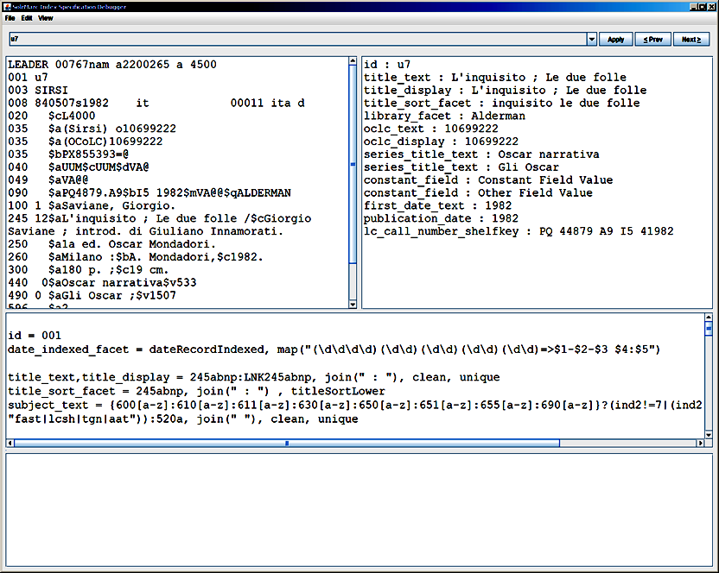
Notes:
Last I’d like to mention that SolrMarc now contains an interactive interface to allow you to work on, edit and tweak an index specification, and see the results for a given record immediately.

Slide 23
Possible Additional Features
Conditional Blocks
a set of index specs that are only processed if certain conditions are true
Referencing other index specs
publication_dates = custom, getAllDates()
sortable_date = ${publication_dates}, first
Notes:
I’ve had a few ideas for additional features that might be useful
such as conditional blocks where a whole set of index specs are only processed if certain conditions are true
or Referencing the results of one index spec in other index specs

Slide 24

Questions
Thanks to Demian for helping to debug the new program and push it toward a release
Thanks for the invite.
*Not affiliated with Maryland Area Regional Commuter Rail System

